Slide 1

Promise and perils of deploying LLMs for aging research and clinical applications
Daniel Khashabi
Notes:
Thank you for having me! It's an honor to be here!

Slide 2
About me
Research agenda: developing theories and empirical approaches to make AI systems capable of robust and transparent communication
Notes:
I am an assistant professor of computer science in Hopkins.
The primary focus of my research is to …

Slide 3
Research agenda: developing theories and empirical approaches to make AI systems capable of robust and transparent communication
Evaluation (defining the problem)
Algorithms (solving the problem)
Applications (translate to the world)
Notes:
Broadly, my team pursues this goal in terms of more focused subgoals:
First, we focus on evaluation. It is crucial to define qualitative ways to measure qualities that we expect from these models.
Second, we develop algorithms for effective development of language modes.
Third, we are excited to deploy these models in real applications to better understand the gap between technology and the needs in real applications.
And obviously, all these thrusts go hand in hand and they fuel each other.
On application, in particular, that I am only we are recently excited to think about is the topic of this workshop today, aging research
That’s what I am going to focus on. And in doing so, I will be making bridges to my other focuses in evaluation AI models and improving them.

Slide 4

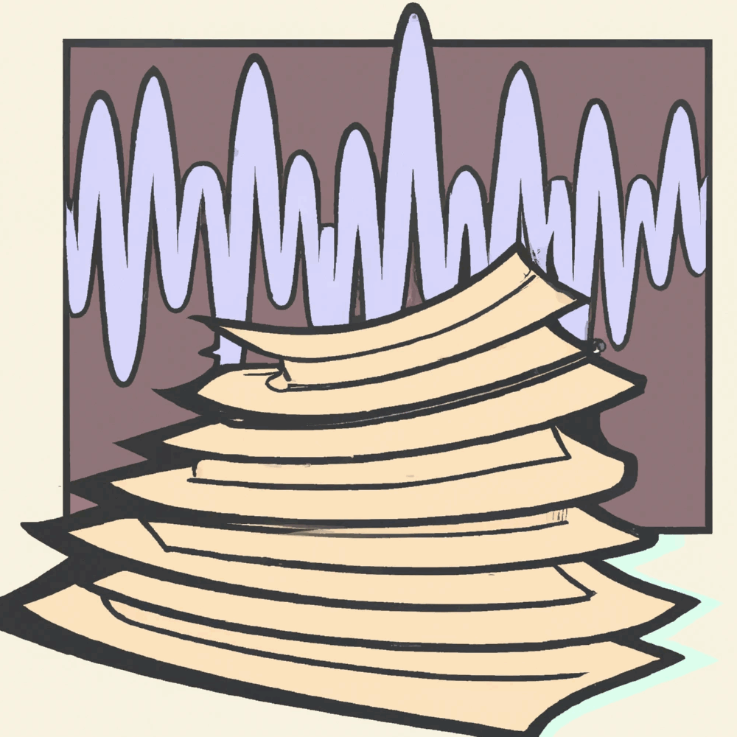
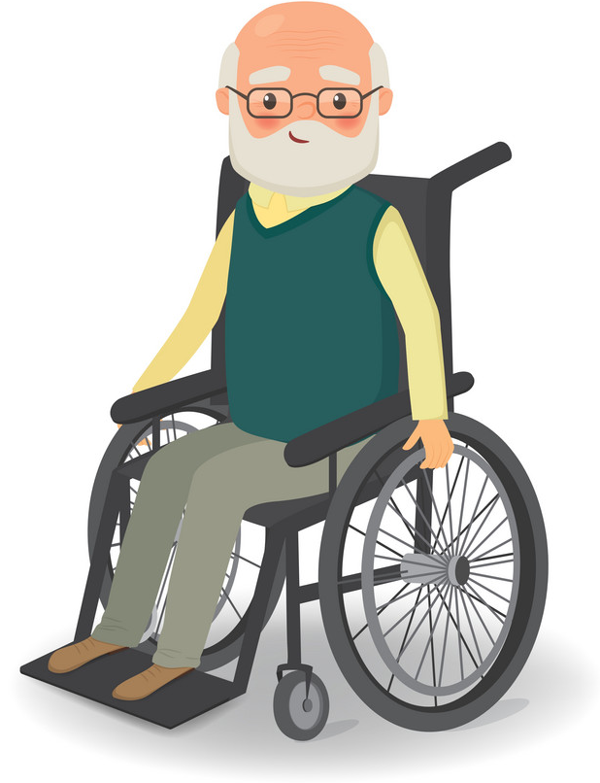

LLMs + Aging Research
Applications (translate to the world)
Research applications
Clinical applications
🤖
🤖
Notes:
When I think about the role that LLMs can play in aging research, there are various scenarios that come to mind. Notably:
Using LLMs to aging research: using them to discover patterns from data which can then be used, for example, for drug discovery or gene-desease association.
Using LLMs in clinical setting to help patients (through chatbots or embodied agents that would interact with your patient).
I am not going get into the details of these applications.
I am just putting these here to set the context but I will discuss several issues at the high-level.
Given the success of general-purpose models like GPT4, these sound like no-brainer. What can go wrong?

Slide 5

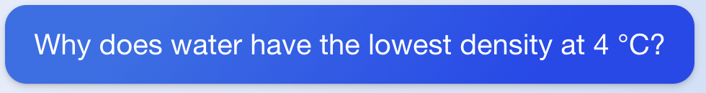
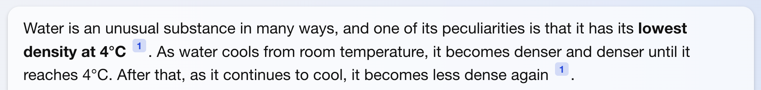
LLM failures
🤖
(fetched on Aug 30, 2023)
The boundaries of these failures are unknown.
⟹ safety problem
Notes:
By this time, we have plenty of evidence on brittleness and various failure modes of LLMs.
Brittleness, Hallucination, insistent …
Here is an example …
But more important that the failures themselves is that, the boundaries of these failure modes are unknown. Most often, we don’t know when they will happen.
And lack of control means =⇒ safety risks (to patients, to the scientists, at the downstream of these models.)
So the theme of today is:
Understanding the roots of the failure modes
Mitigating unknown failures

Slide 6
LLM failure vs. distributional properties of data
Controlled experiment: Question accuracy for fixed relationship and varying subjects.
🤖
Q: Who was the director of The Titanic?
Query
Response
Hypothesis: Popularity predicts factual accuracy?
Mallen et al. When Not to Trust Language Models: Investigating Effectiveness of Parametric and Non-Parametric Memories, ACL 2023
Notes:
A hypothesis that we recently explore is …
Okay so why does it matter for aging? I will mention that in a little bit.
But for now, here is an experimental setting:

Slide 7
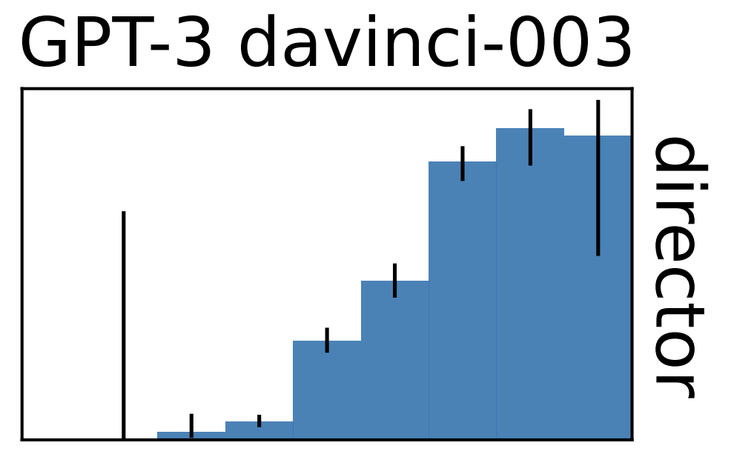
LLM failure vs. distributional properties of data
Controlled experiment: Question accuracy for fixed relationship and varying subjects.
Q: Who was the director of The Titanic?
accuracy
subject log-popularity
🤖 text-davinci-003, “director”
Factual accuracy of LLMs is positively correlated with ”popularity” of information.
Mallen et al. When Not to Trust Language Models: Investigating Effectiveness of Parametric and Non-Parametric Memories, ACL 2023
Notes:
And the corollary is that, Rare events are quite challenging for LLMs.

Slide 8
Distributional properties of aging data
Lab research
Nature is full of rare events
Many disorders have a very low prevalence
Rare events are prevalent in aging research
🤖
Notes:
Data imbalance and rare events in aging research
In aging, rare event effects are very common.
Nature is full of rare events: many disorders have a very low prevalence, which would cause unbalanced class problems in machine learning. We should be diligent in addressing the rarity through both broader data collection as well as analytical solutions. Throughout the analysis, we should pay close attention to the ramifications of such rare events, making sure training and evaluation methods are adapted accordingly.
For example, in Parkinson’s disease, mutations in GBA and LRRK2 genes are rare but with strong effects. These mutations are found more in Jewish Ashkenazi population than other ancestral populations.

Slide 9
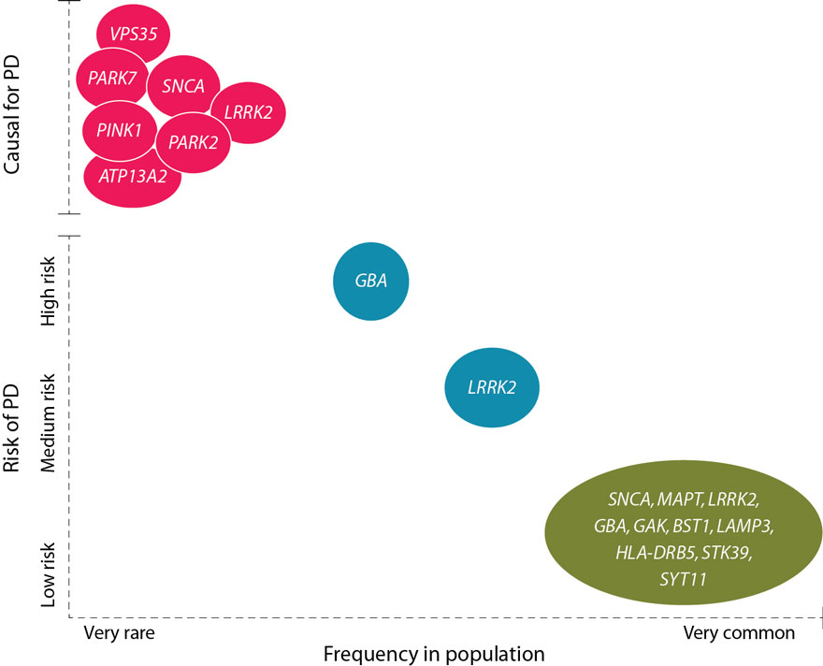
Distributional properties of aging data
Rare gene mutations can have strong effects
Nature is full of rare events
Many disorders have a very low prevalence
Rare events are prevalent in aging research
LLMs are doomed to fail at discovering such rare events.
van der Brug et al. "Parkinson’s disease: from human genetics to clinical trials. Science translational medicine 2015
Notes:
Data imbalance and rare events in aging research
In aging, rare event effects are very common.
Nature is full of rare events: many disorders have a very low prevalence, which would cause unbalanced class problems in machine learning. We should be diligent in addressing the rarity through both broader data collection as well as analytical solutions. Throughout the analysis, we should pay close attention to the ramifications of such rare events, making sure training and evaluation methods are adapted accordingly.
For example, in Parkinson’s disease, mutations in GBA and LRRK2 genes are rare but with strong effects. These mutations are found more in Jewish Ashkenazi population than other ancestral populations.

Slide 10
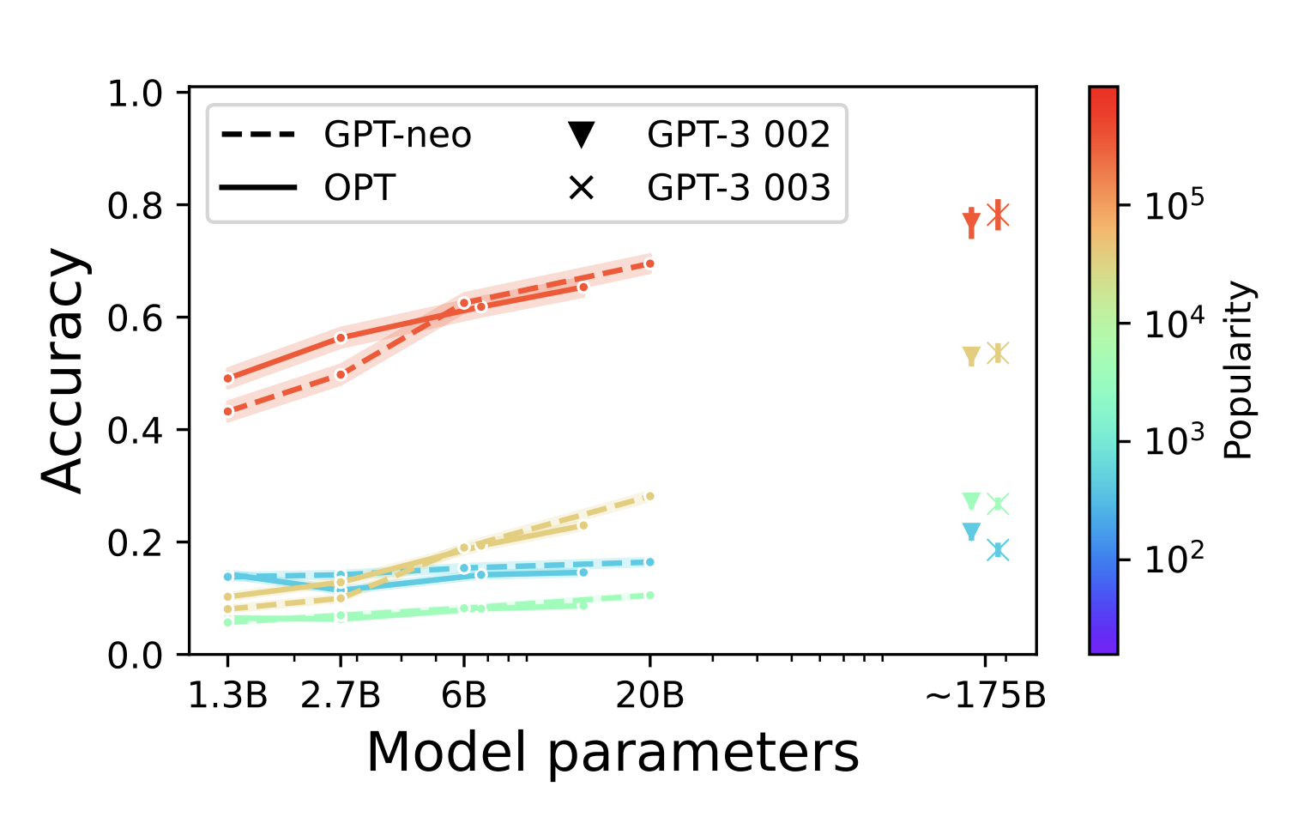

What about “scale”?
slope ≈ 0
🤖
🤖
Scaling models leads to little gains for rare events.
Mallen et al. When Not to Trust Language Models: Investigating Effectiveness of Parametric and Non-Parametric Memories, ACL 2023

Slide 11
Summary thus far
🤖
Aging research involves rare events.
Gene mutations vs. PD
Funding gaps and biases
LLM quality is strongly correlated with popularity of data.
Note, ”popularity” is not an easily-quantifiable measure.
Rare gene mutations can have strong effect
Notes:
So, if you’re going about discovering new rare events (e.g., gene mutations), with a good chance LLMs will miss it.
Is it better or worse than humans? Unclear. We should look into this.
Now what else can we do make LLMs robust to tail phenomenon?

Slide 12
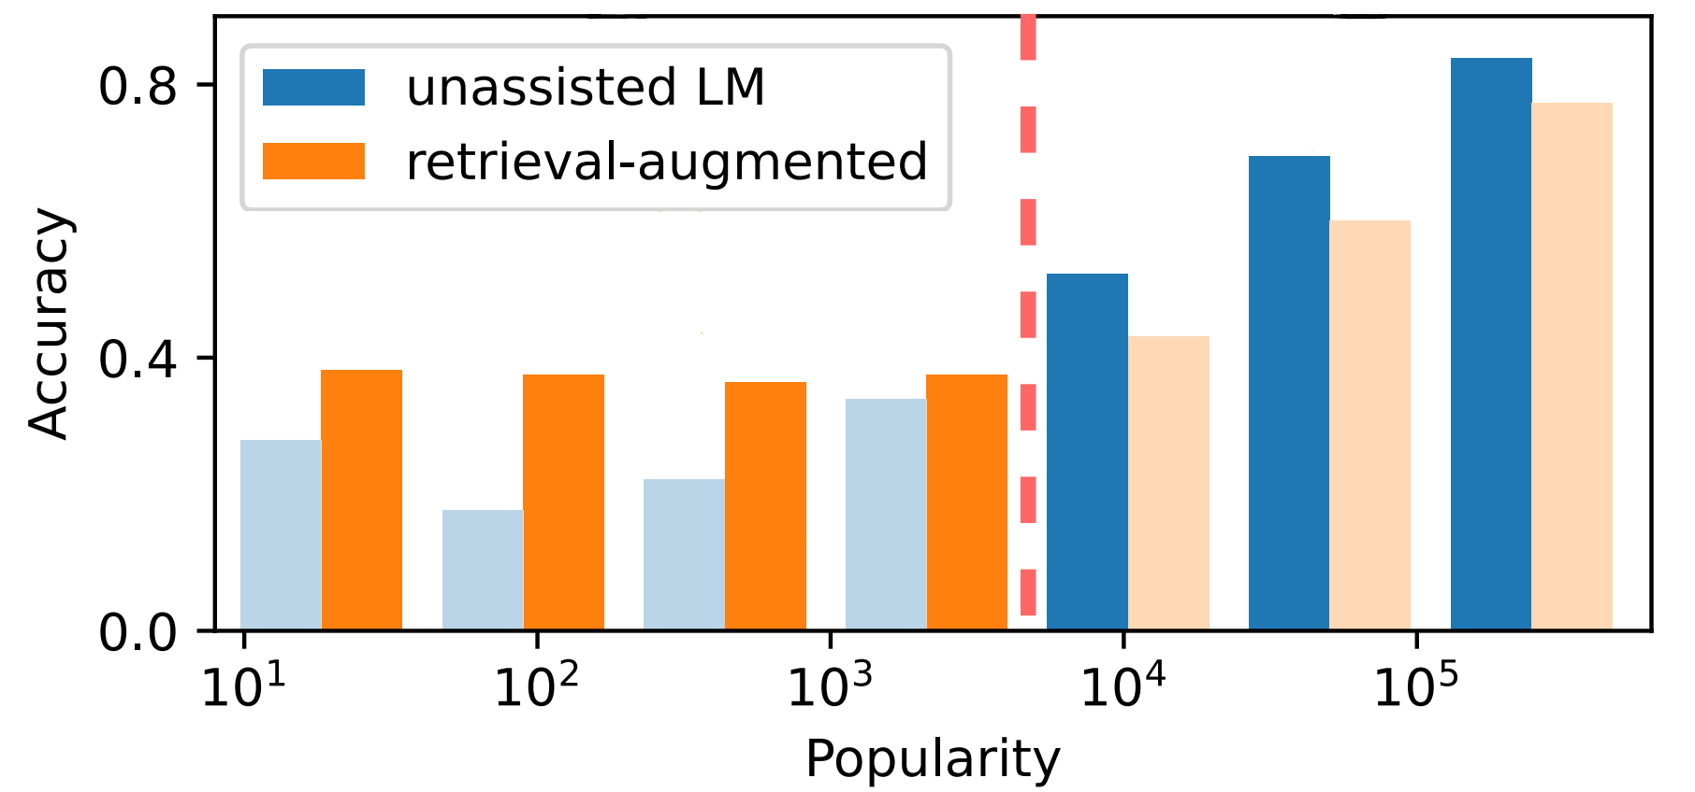
Augmenting LLMs with relevant context
🤖
Query
Response
internet
Non-parametric knowledge
Non-parametric knowledge helps rare events, but may hurt popular phenomena.
Mallen et al. When Not to Trust Language Models: Investigating Effectiveness of Parametric and Non-Parametric Memories, ACL 2023
Gautier Izacard et al., “Unsupervised Dense Information Retrieval with Contrastive Learning” (2022)
Notes:
One common is to contextualize these models with relevant information.
You go to web, retrieve a bunch of relevant stuff, and hope that language model knows how to incorporate them.
Turns out that

Slide 13
Grounding LLM generations
Allow LLMs to connect/attribute their generations to the real world.
🤖
Query
Response
generations
This is because the following paper concluded that …
Notes:
Another approach is to ground information,

Slide 14
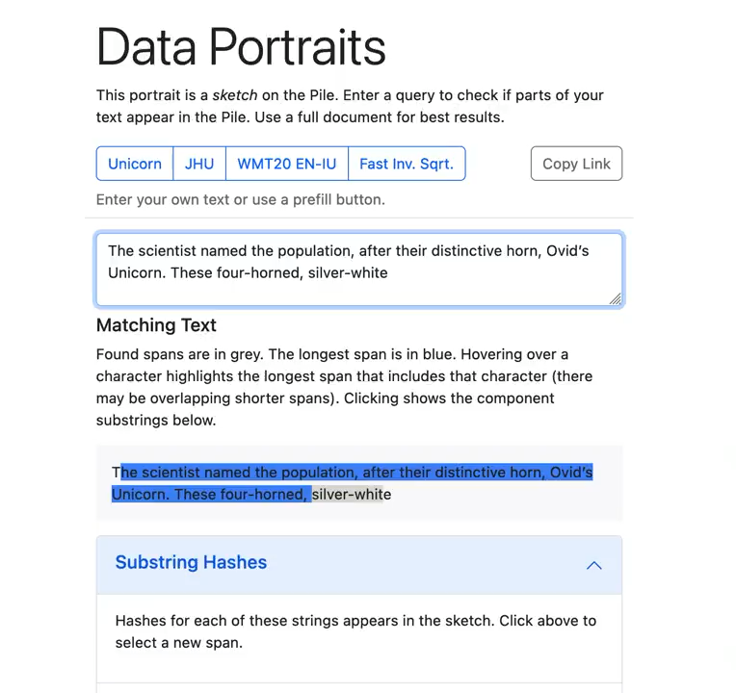
Verifiable Grounding LLM generations
“Data Portraits”
Fast membership query in large corpus (whether a string belongs to your data)
Implemented via Bloom filter.
Allows us to develop chatbots that are trained to “quote” (work in progress)
Tradeoff between reliability and creativity
https://dataportraits.org
Marone and Van Durme. "Data portraits: Recording foundation model training data." arXiv 202).
Zhang et al. [work in progress]
Notes:
Grounding in a way that allows you to verify their source.
A key building
The demo that I am showing here, is a tool that one of our students has build that allows you to quickly verify which portions of a paragraph were written directly in a corpus that you trust.
This makes verifiability of information easy, but it limits any potential creativity of the model.

Slide 15
Key bottleneck for progress: feedback
The success of LLMs is due to rich feedback signal.
Average humans are very good at telling apart good responses.
Aging problems:
Humans do not necessarily know what is good or not.
Understanding causal connection between parameters and effects require real experiments over a time-horizon.
We do not necessarily know what we are looking for.
OpenAI’s future chatbots won’t solve the aging problem.

Slide 16
In the short term …
🤖
LLMs provide value-add in certain niches of aging research.
This requires careful context-specific guardrails.
Examples:
LLMs helping crunch through tables
LLMs extract information from papers
…
LLMs will remain to be brittle/inconsistent, on important problems.
The gains of ”scale” will be minimal, in the short term.
Notes:
I think scale is not the solution. As I showed earlier, most of the gains that you get correspond to phenomena that are more frequently-observed.

Slide 17
In the long term …
🤖
The key is to identify rich sources of feedback.
E.g., LLMs as part of the clinical/medical research cycle.
Growing LLMs as part of data generation ecosystem.
Requires extensive safety considerations.
Hypothesis generation
Experiment
Measurement
Analysis and conclusion

Slide 18






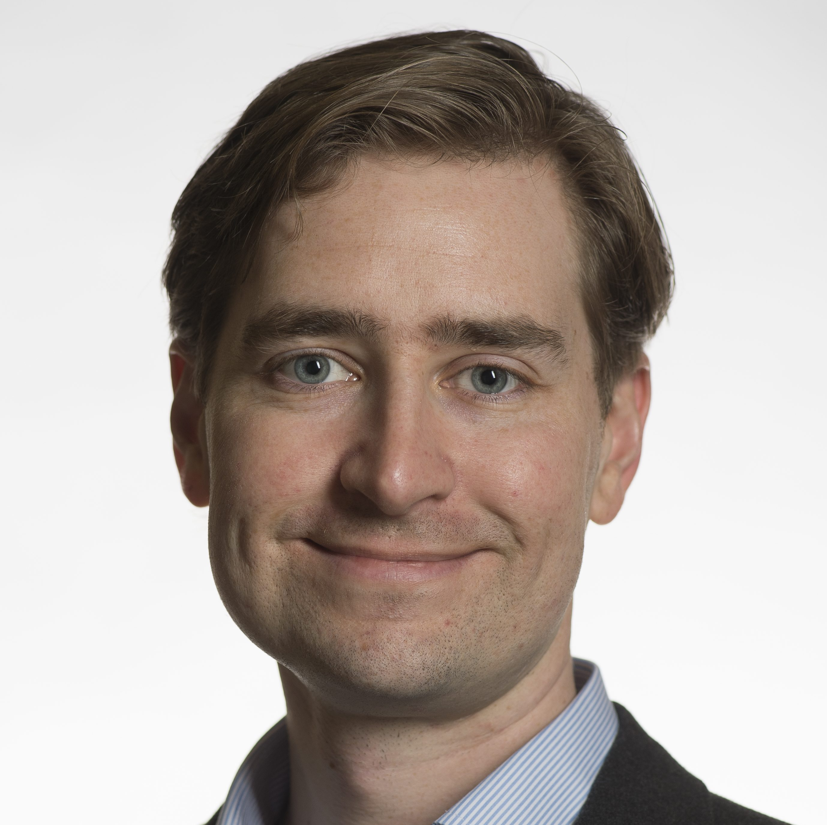
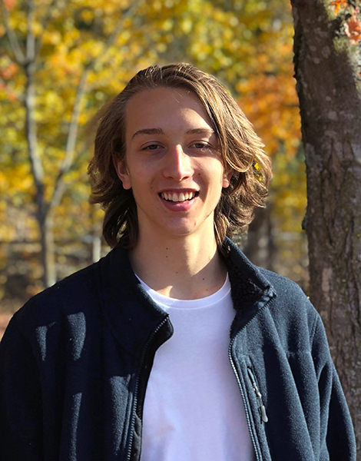


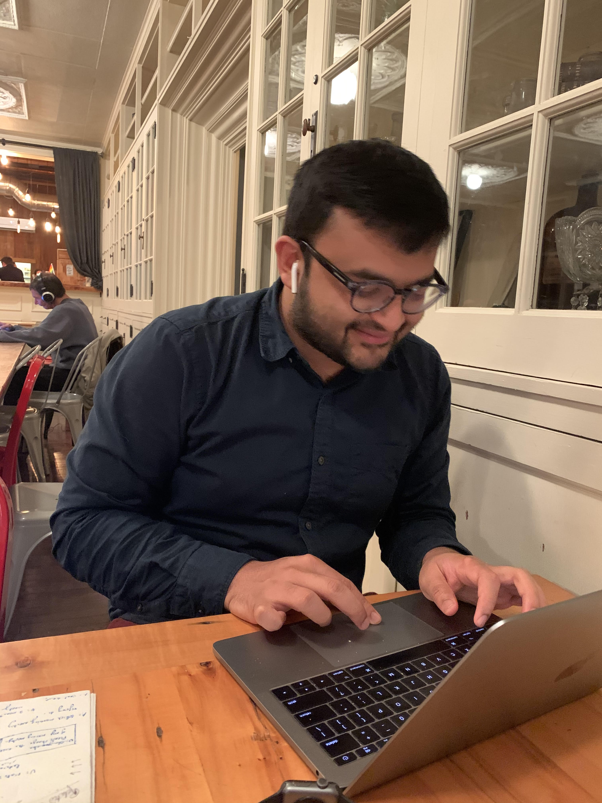
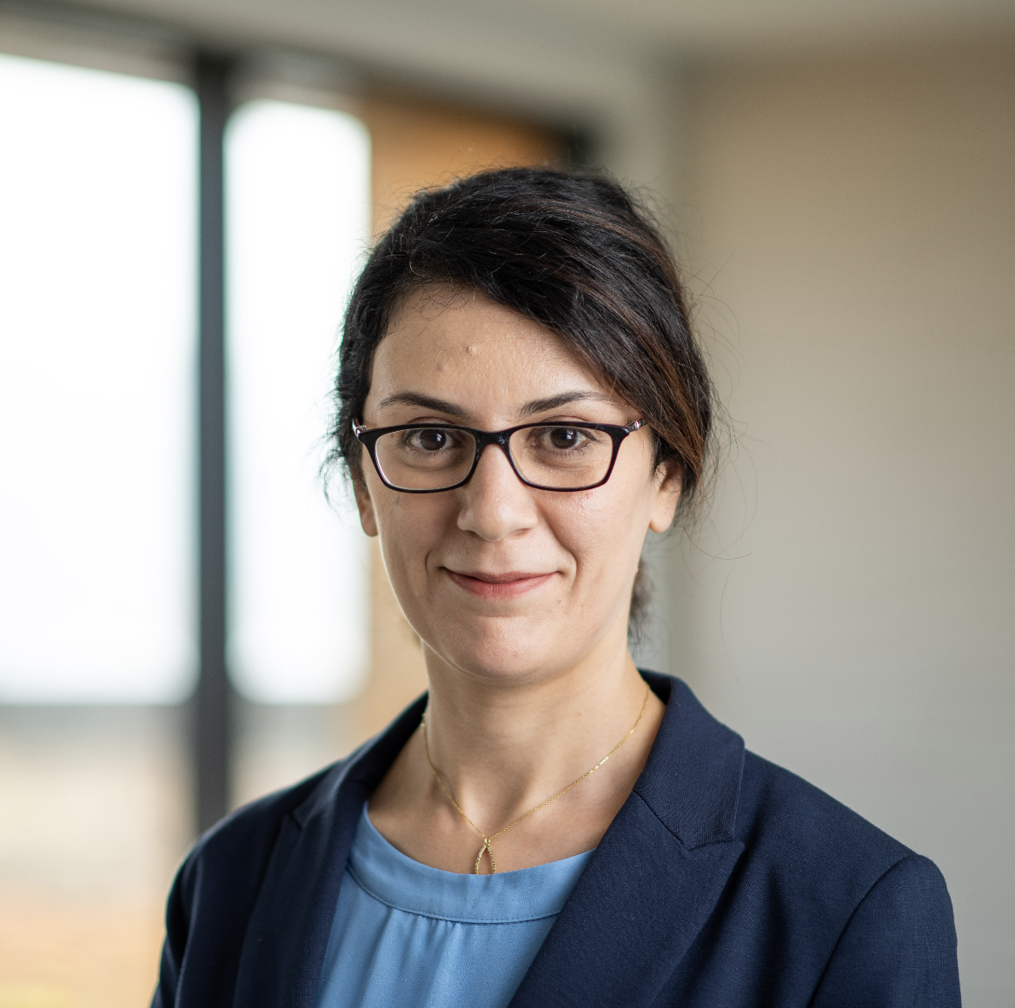



Collaborators:
Funding:
Notes:
And finally, I’ll end with a shout out to my collaborators that made all these works possible!

Slide 20

Intelligence Continues to be a Moving Target
Every step forward, we realize there are new challenges.
Unless there is a revolution outside AI (energy, hardware, etc.), we need a lot more innovations.

Slide 21
End with open questions:
Role of RLHF and its necessity
Other aspects that we can’t capture
Curiosity
Altruism
…

Slide 22
Changes:
Problem statement: how to reduce load of human annotators when aligning LLMs?
Why? Expensive,
less diverse,
misalignment between pre-training and human feedback potentially leading to hallucination
if we train a model to imitate human-generated text, it may learn to output common misconceptions (Lin et al., 2022). Or if we train a chat bot to optimize a reward such as engagement, it may learn to generate text that is compelling but false (Roller et al., 2021). If we try to reward model outputs that look true, a model may still learn to output false text if human raters can’t evaluate the correctness of that text (Kenton et al., 2021).
Instead, use LM itself
Somewhere add a reminder: we want to use a Vanilla language model
End with open questions:
Role of RLHF and its necessity
Other aspects that we can’t capture
Curiosity
Altruism
…

Slide 23
Academia has to go slow[er] and understand things.
Slow enough to understand why things work or do not work.
Today: Revisit two relevant technological pieces that deserve further deliberation.
Notes:
Our job in academia, I believe, is to do the opposite. We go slow, understand them.
So in the spirit of this moving slow, today I would like to revisit several technological pieces that have been with us for a 3-4 years.
But

Slide 24
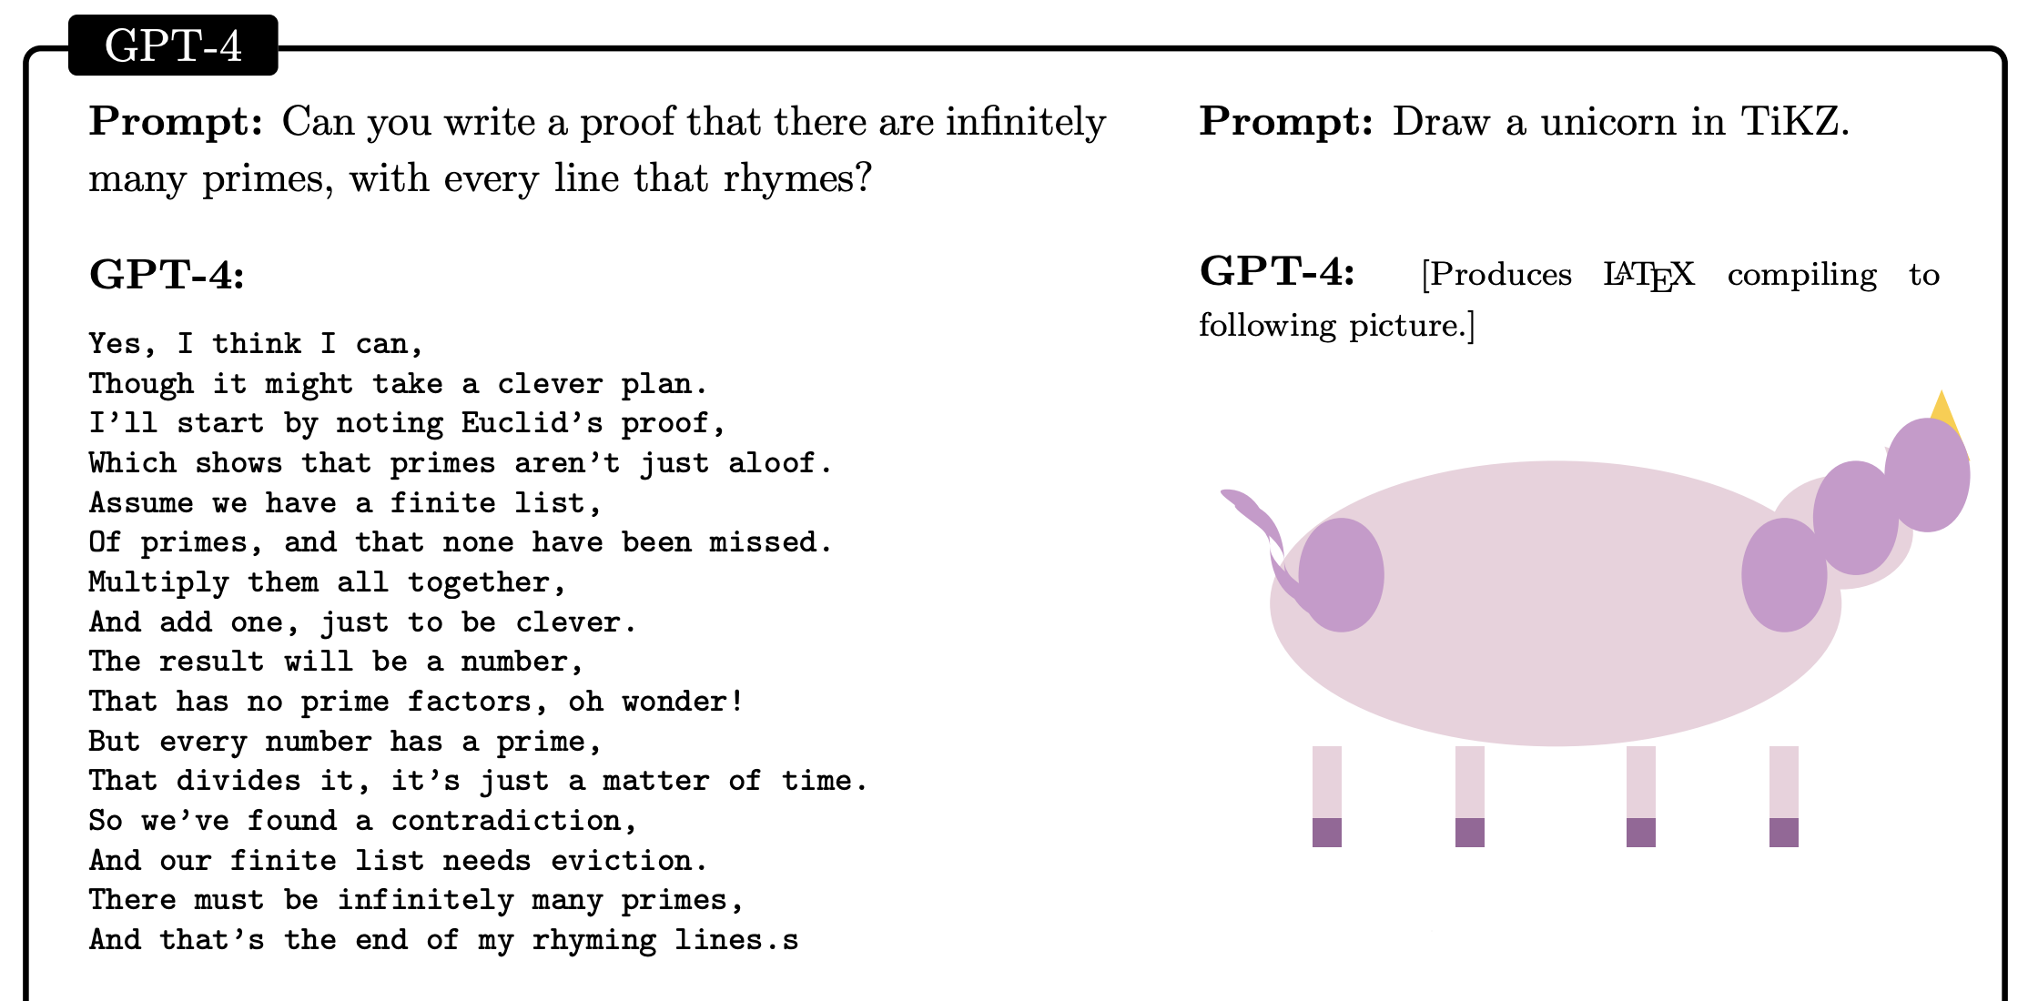
The success we dreamed of
[Sparks of Artificial General Intelligence: Early experiments with GPT-4, Bubeck et al. 2023]

Slide 25
Is ICL ~ Optimization off the table?
Deep inside, I believe that there must be a connection between ICL and optimization algorithms — we’re just not looking at it right.

Slide 26

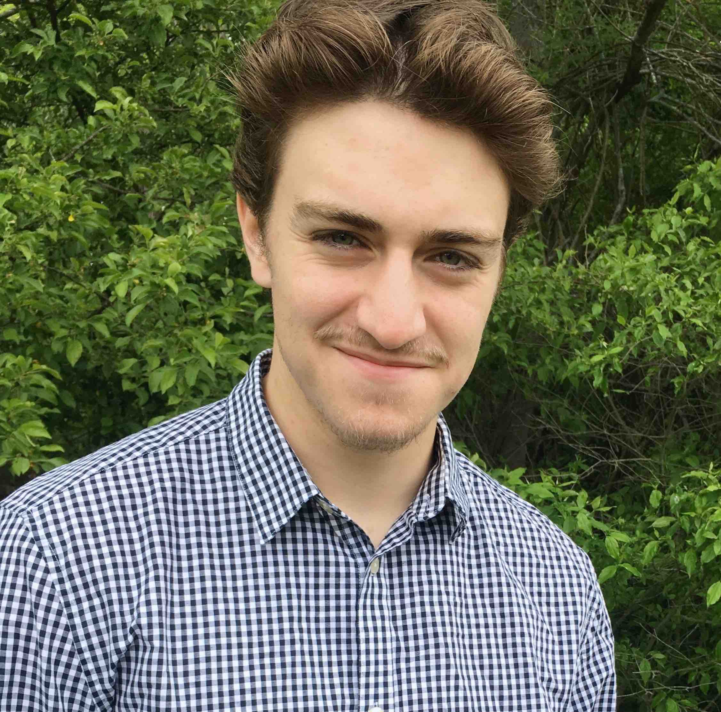
Collaborators:
Funding:
Notes:
And finally, I’ll end with a shout out to my collaborators that made all these works possible!

